Slide 1
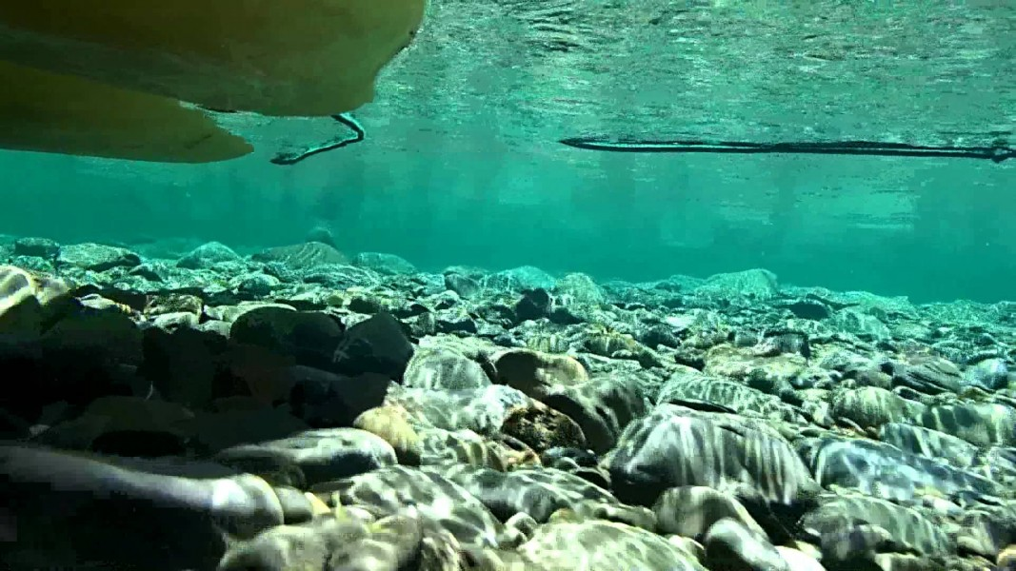
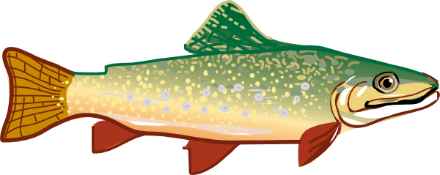
If You Were a Fish
Created By:
Appalachian Watershed Research Group
The Voinovich School of Leadership & Public Affairs
Ohio University
A special thanks to the AEP Foundation!

Slide 2
What characteristics would you want in your stream if you were a fish?
Think of 5 characteristics and record them on your paper

Slide 3
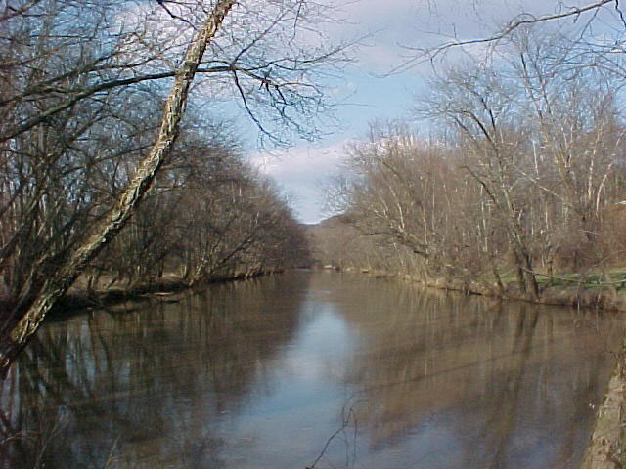
Run
The main body of a stream that runs smoothly downstream

Slide 4
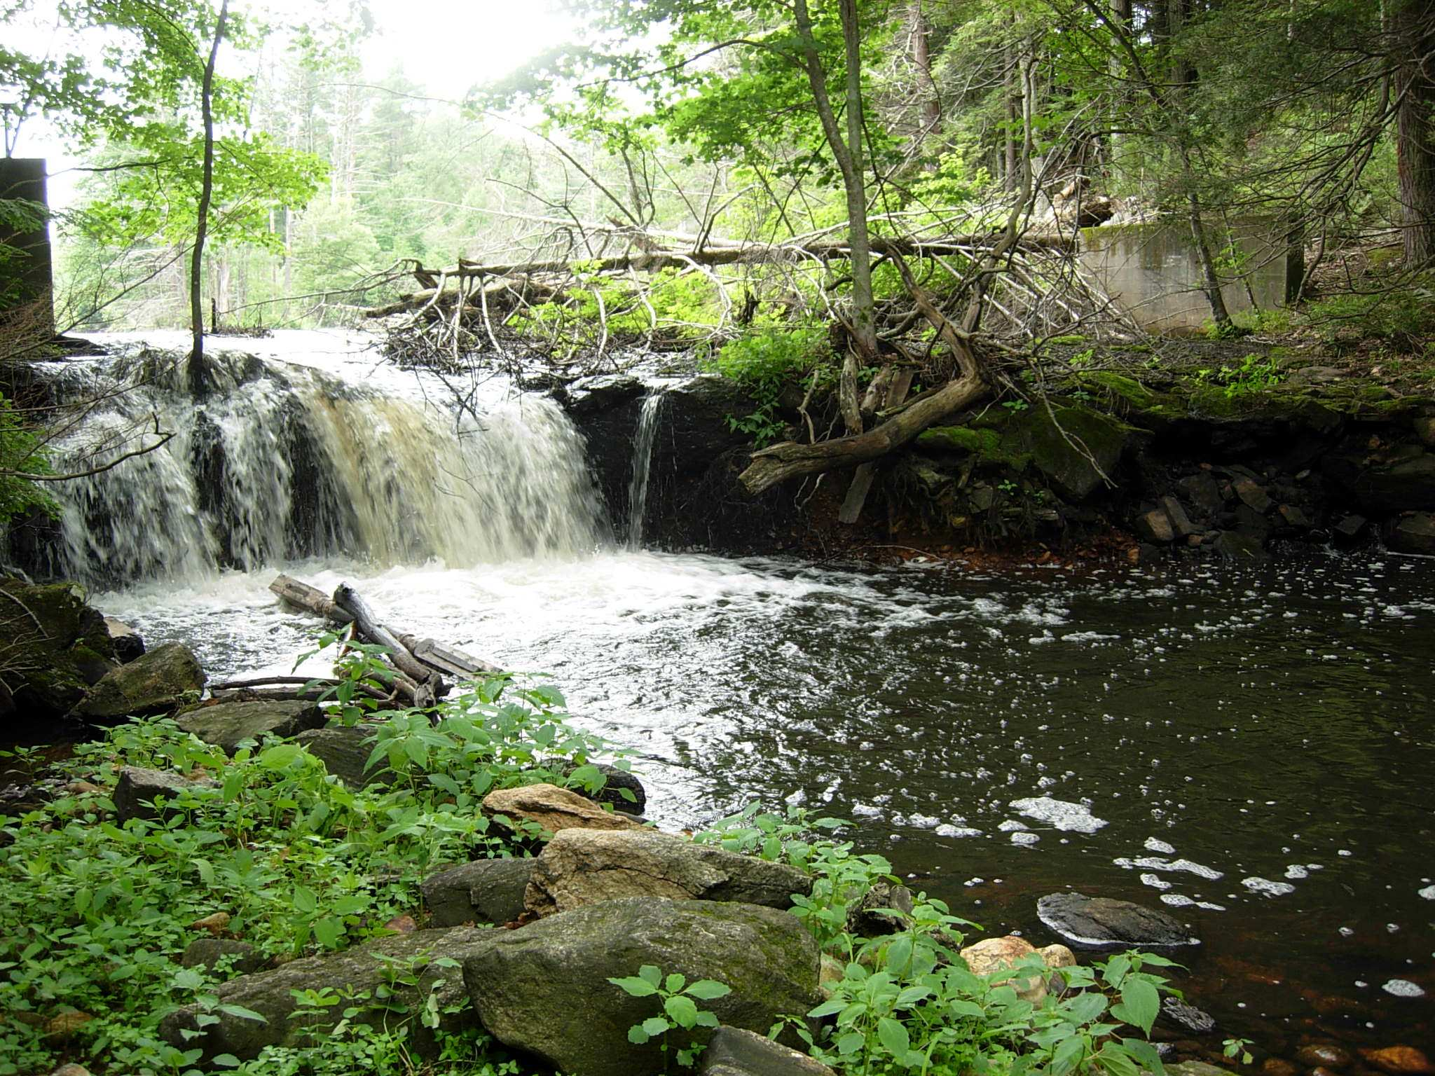
Pool
Deep areas of slow moving water

Slide 5
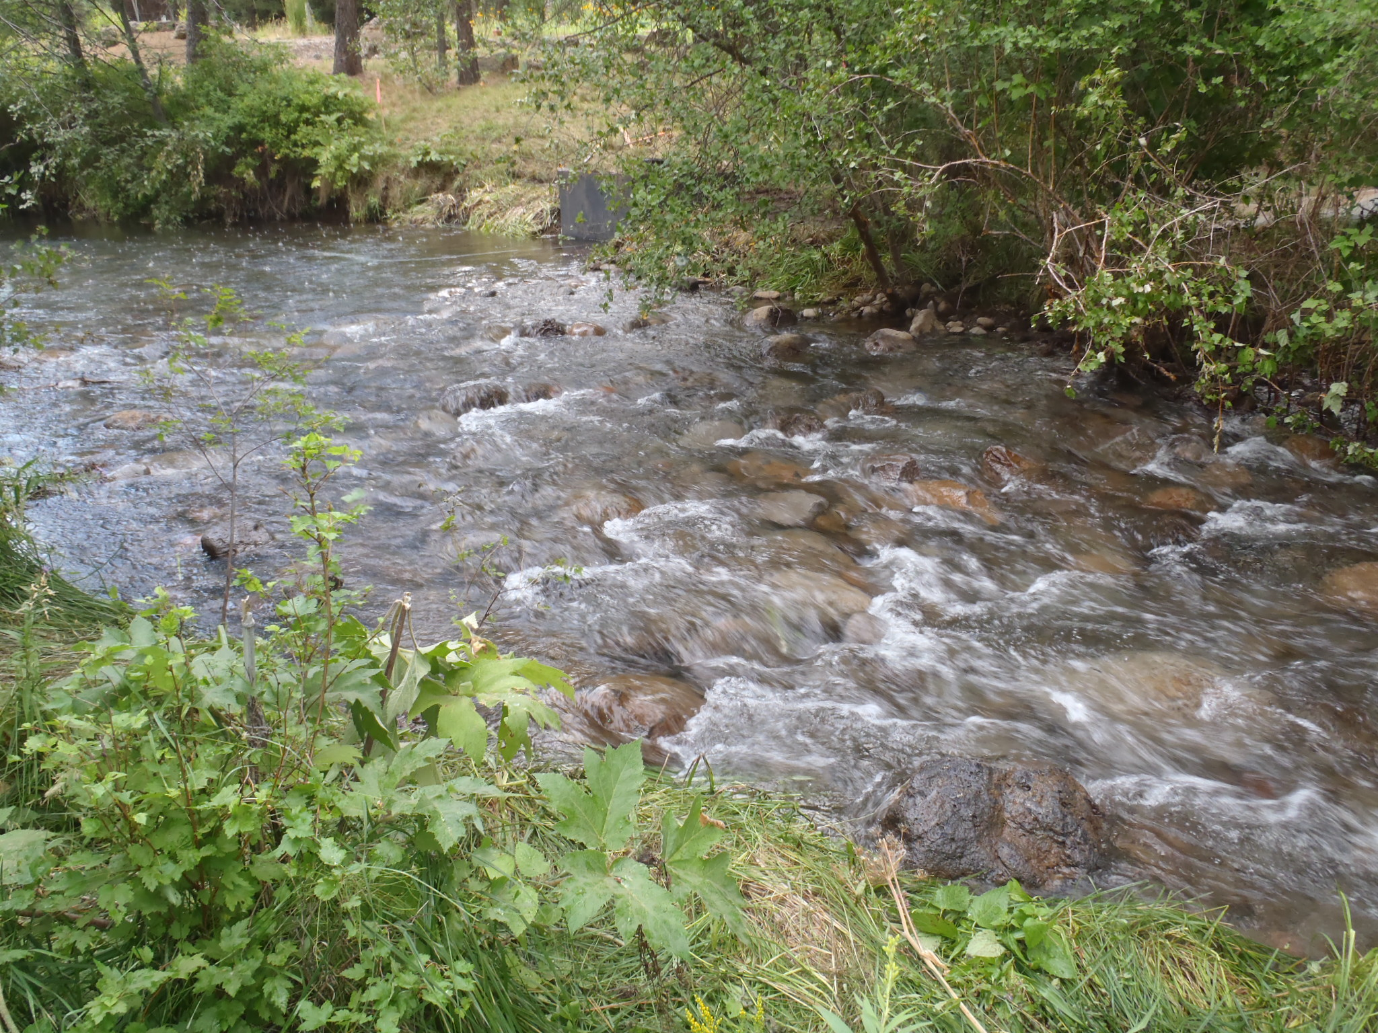
Riffle
A rocky or shallow part of a stream or river through rough water

Slide 6
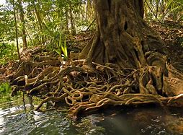
Root Wad
The trunk of a dead tree with the roots attached and the soil removed so that the roots are exposed

Slide 7
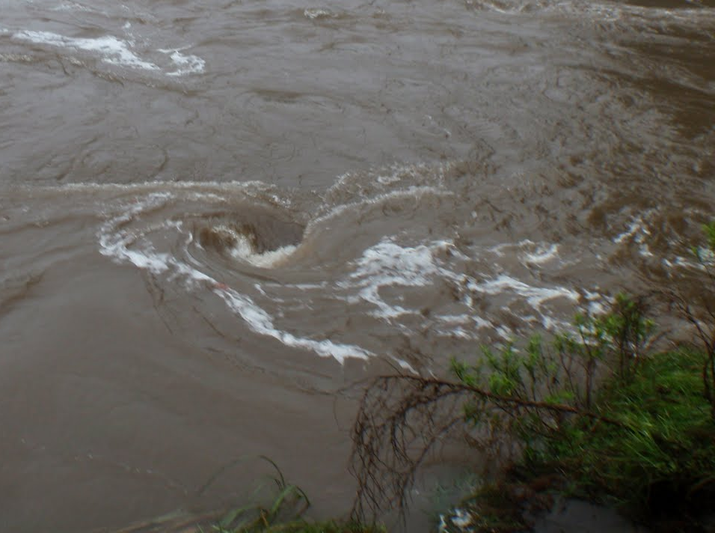
Eddy
A circular current of water

Slide 8
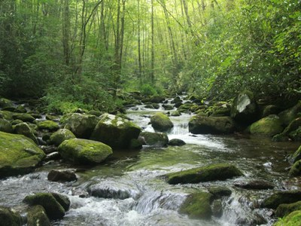
Riparian Zone
The bank of a stream, typically filled with vegetation

Slide 9
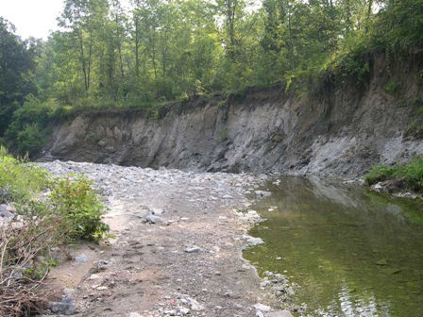
Eroded banks
Evidence of erosion on the outside bank of a stream

Slide 10
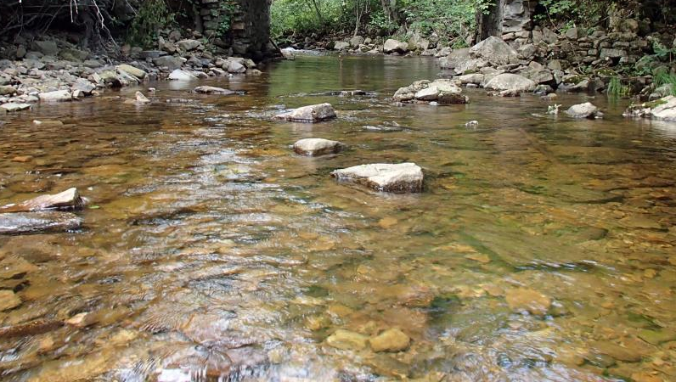
Substrate
The sediment or material (ex. rocks) at the bottom of the stream

Slide 11
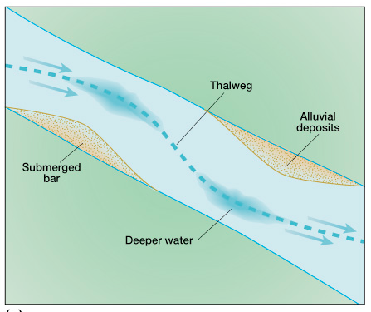
Thalweg
A line following the lowest part of a valley or stream channel

Slide 12
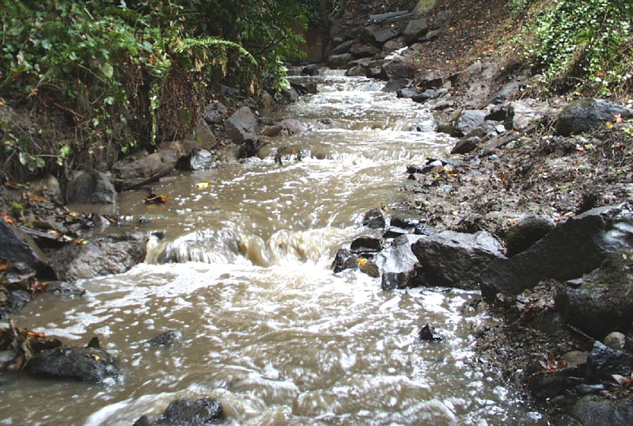
Stream Channel
The path of water and sediment flow between banks

Slide 13
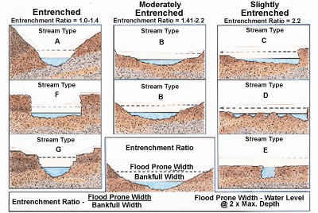
Entrenchment
The vertical containment of the stream, indicator of erosion

Slide 14
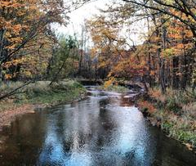
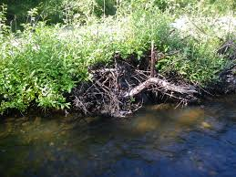
Photo Word Bank
Pool
Riffle
Run
Eddy
Riparian
Cut bank
Thalweg
Rootwad
Stream channel
Substrate
Entrenchment

Slide 15


Special Thanks To:
Appalachian Watershed Research Group
The Voinovich School of Leadership & Public Affairs
Ohio University
AEP Foundation

